Slide 1

Finance $ Risk Analytics
Jeetendra Sarpe

Slide 2

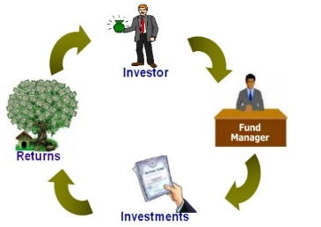
Introduction
Every individual or business actively searches for opportunities to get the maximum returns.
A portfolio manager makes investment decisions and carries out other related activities on behalf of vested investors.
The portfolio manager uses the available resources to provide the best solution to the investor.

Slide 3
Data
You are provided with the following information for 24 stocks of leading companies listed in New York Stock Exchange(NYSE).
The information for every stock ranges from 1st October 2010 to 30th September 2020.
The stocks belong to different domains:
Technology/IT
Travel/Aviation/Hospitality
Banking/Financial Services and Insurance
Pharmaceuticals/Healthcare/Life Sciences
To help you with the market benchmark, you are given the S&P 500 index prices for the same period.

Slide 4
Contents
Date
Open price: Price of stock at the start of the day
Close price: Price of stock at the end of the day
High price: Highest price reached by the stock on that day
Low price: Lowest price reached by the stock on that day
Adjusted close price: Stock price adjusted to include the annual returns (dividends) that the company offers to the shareholders
Volume traded: Number of stocks traded on the day

Slide 5
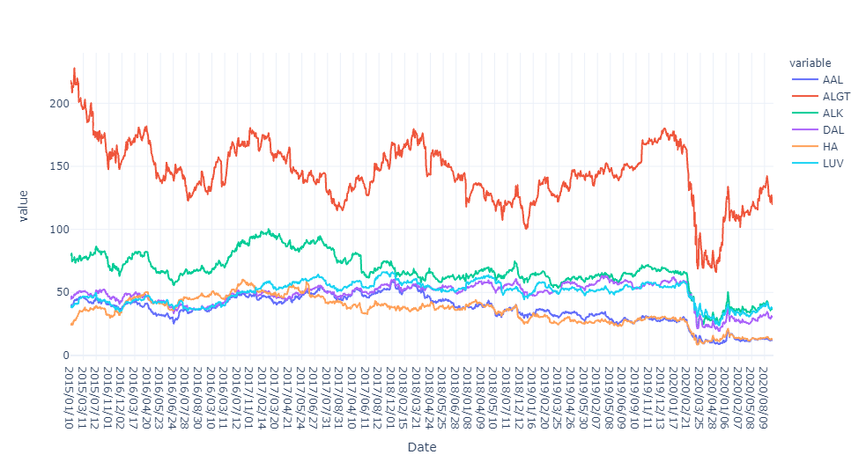
Travel/Aviation/Hospitality Sector

Slide 6

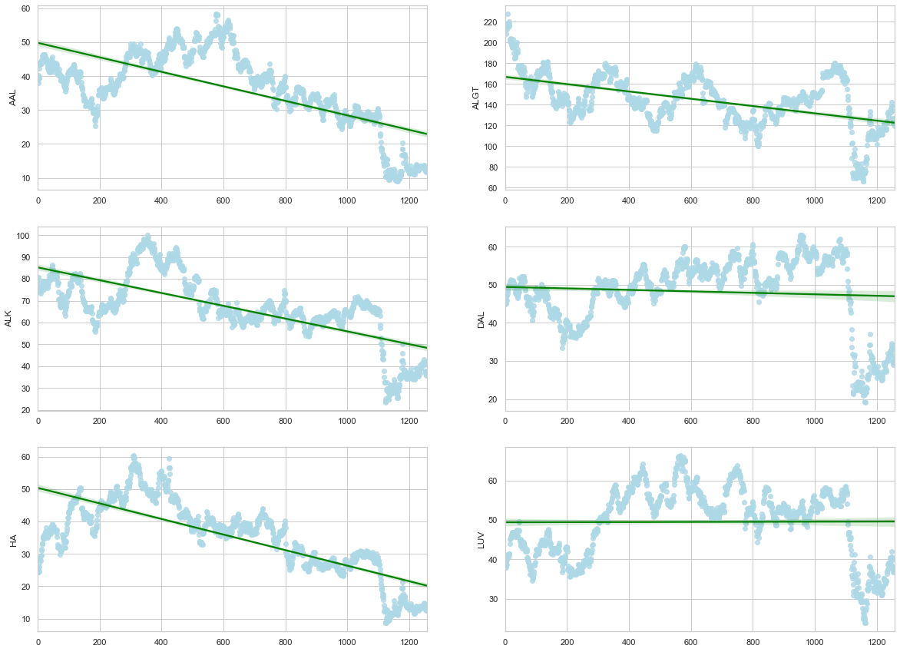
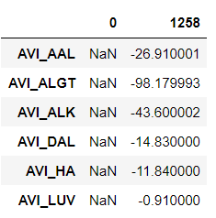
The Price difference between the initial and the final day of the stock records show poor performance of this sector. The best among this LUV is shortlisted for further analysis.

Slide 7
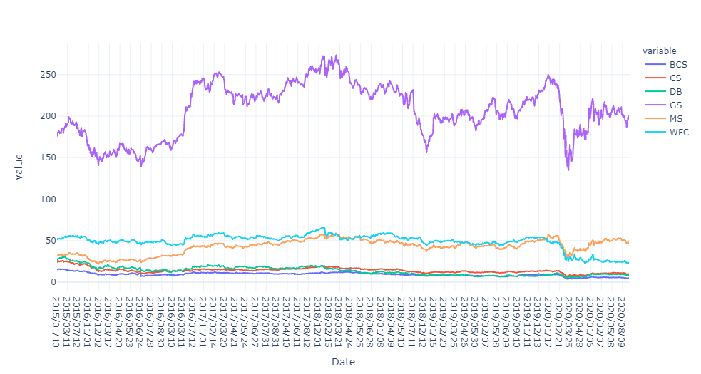
Banking/Financial Services and Insurance

Slide 8
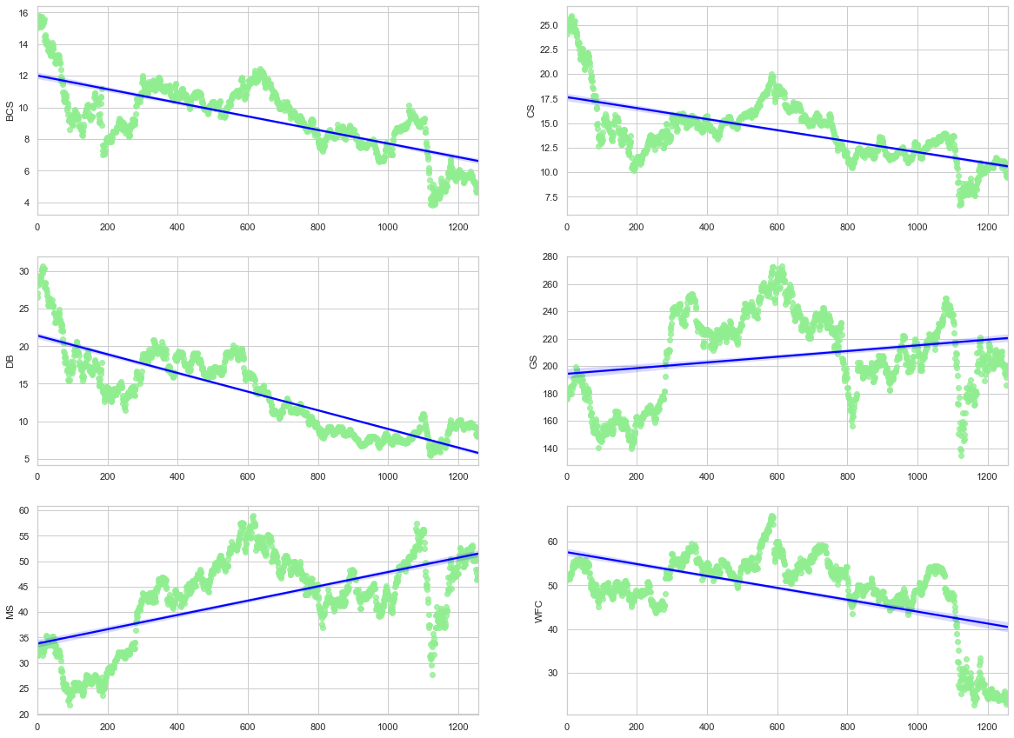
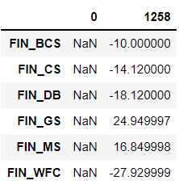
Only GS and MS companies stocks are performing better in this sector, and also selected for future analysis.

Slide 9
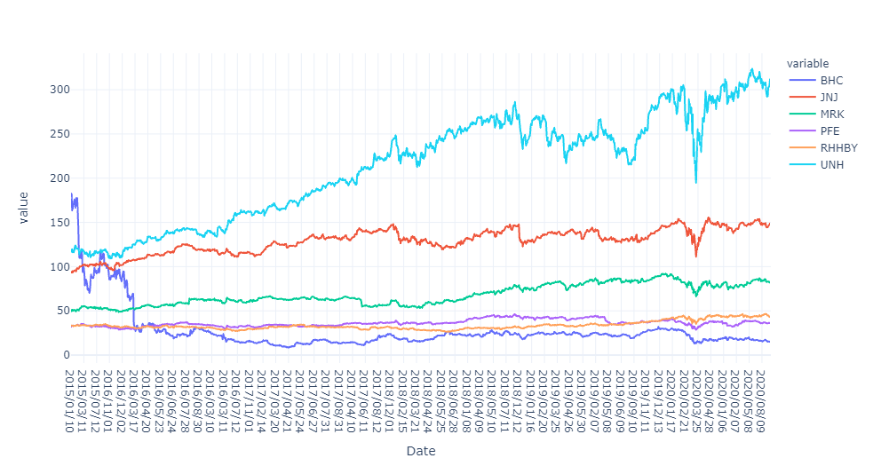
Pharmaceuticals/Healthcare/Life Sciences

Slide 10

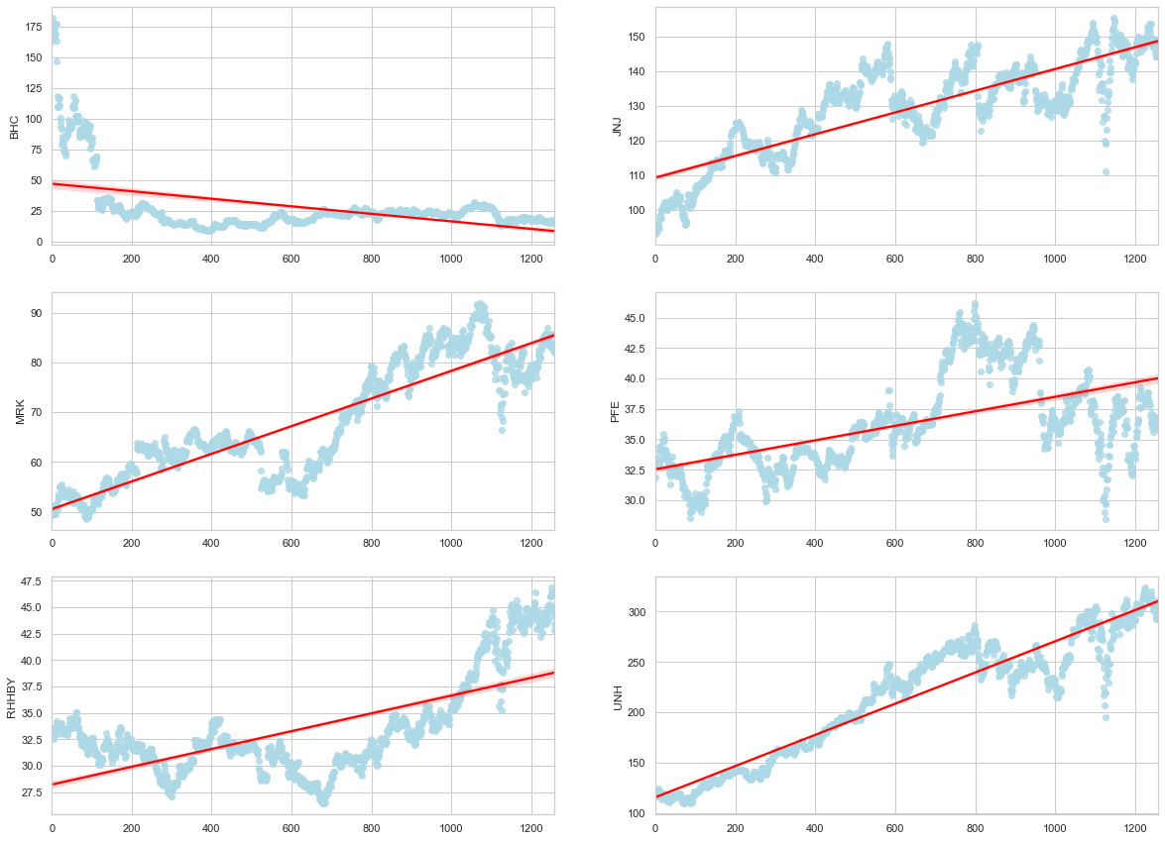
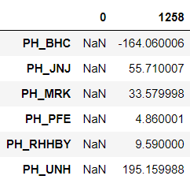
Considering JNJ, MRK, UNH and RHHBY for further analysis.

Slide 11
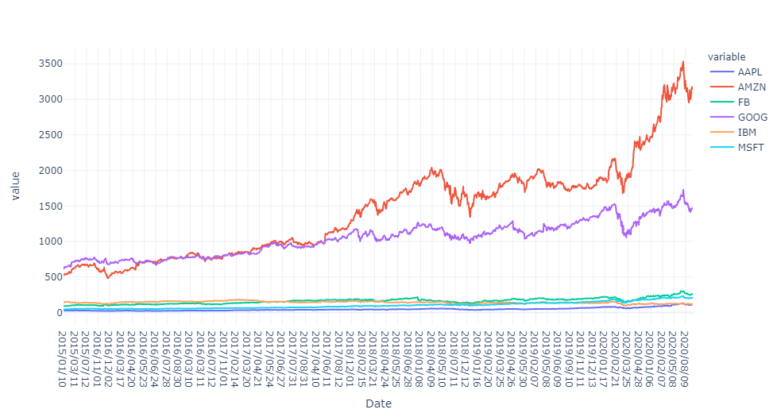
Technology/IT

Slide 12
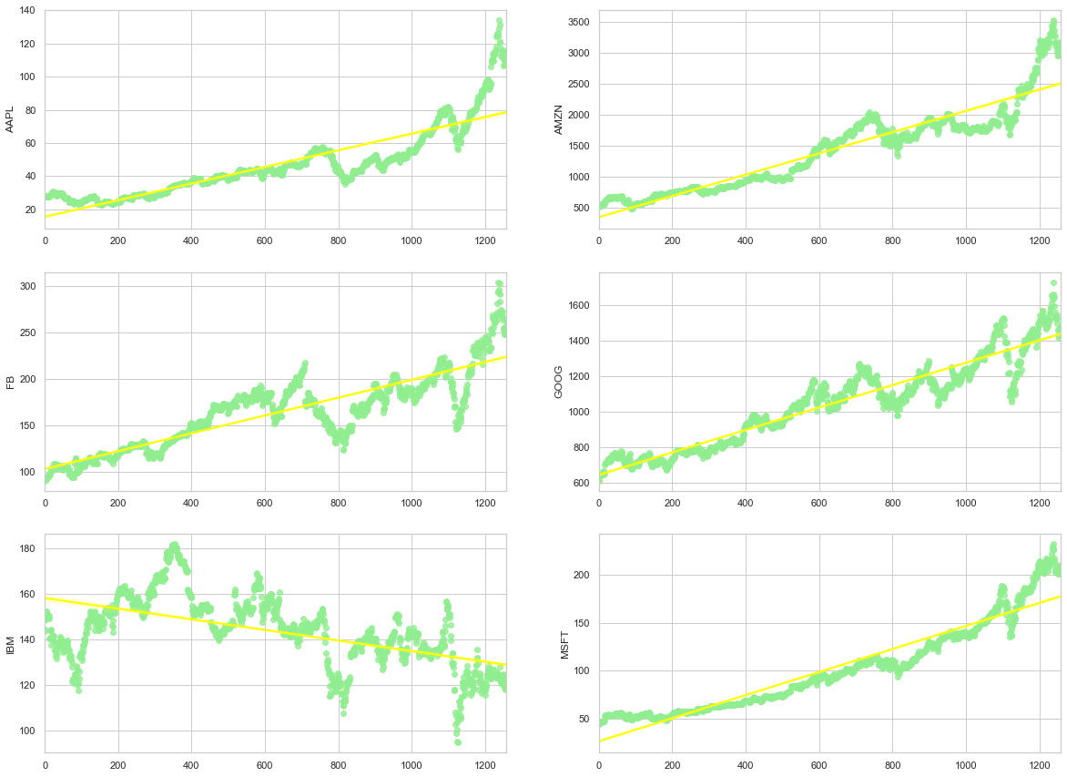
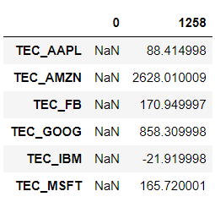
IT sectors looks to perform with par to the market. AMZN,FB,GOOG and MSFT will be analyzed with respect to market.

Slide 13
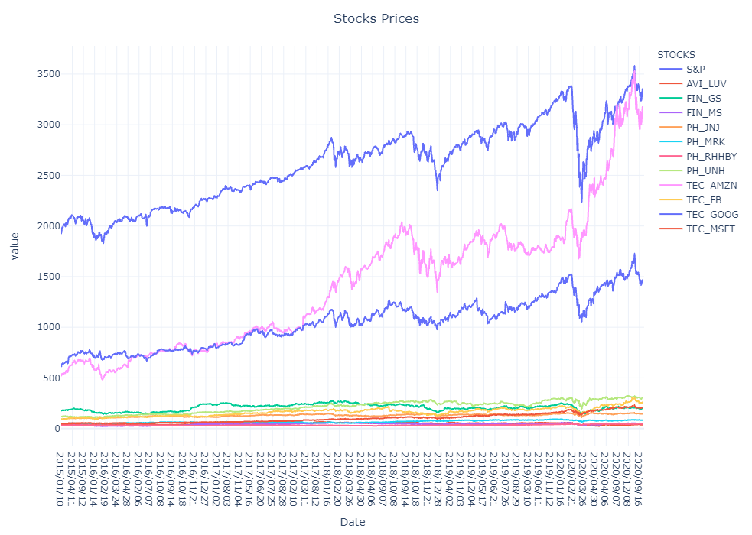
Cleaned Data

Slide 14
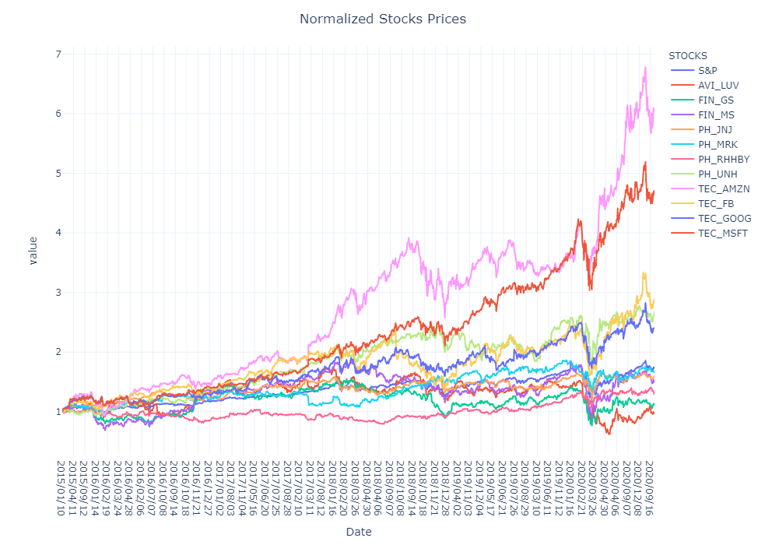
Normalized Stock Prices

Slide 15
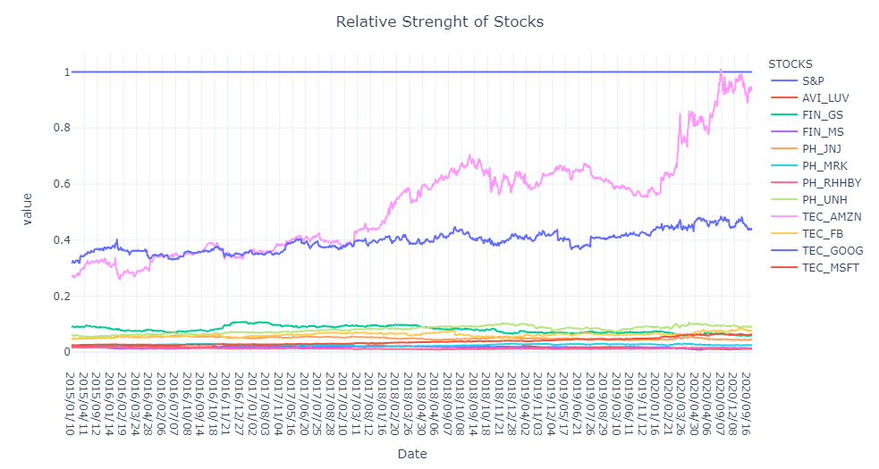
Relative Strength

Slide 16
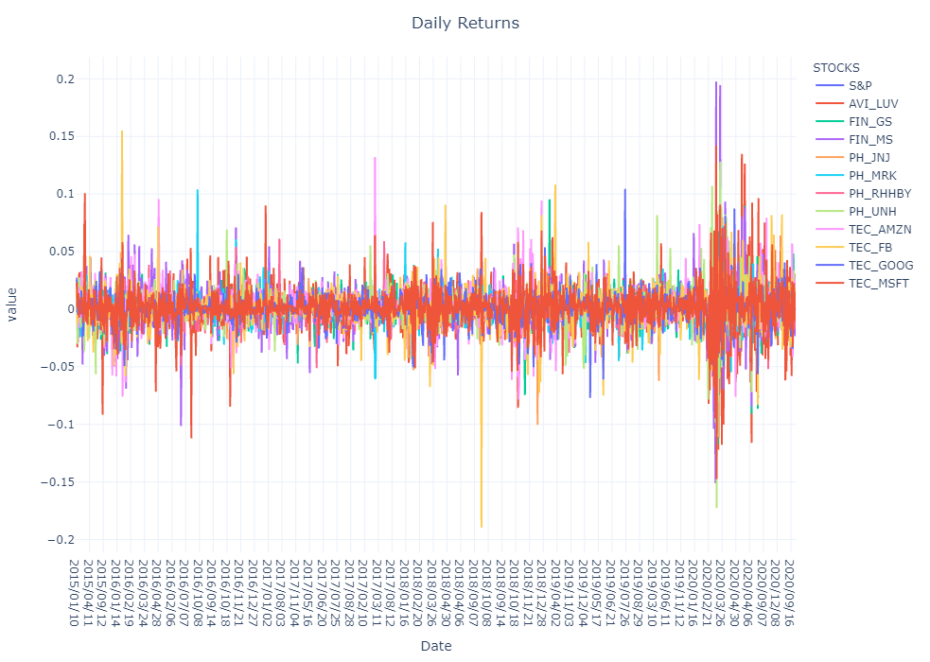
Daily Returns

Slide 17
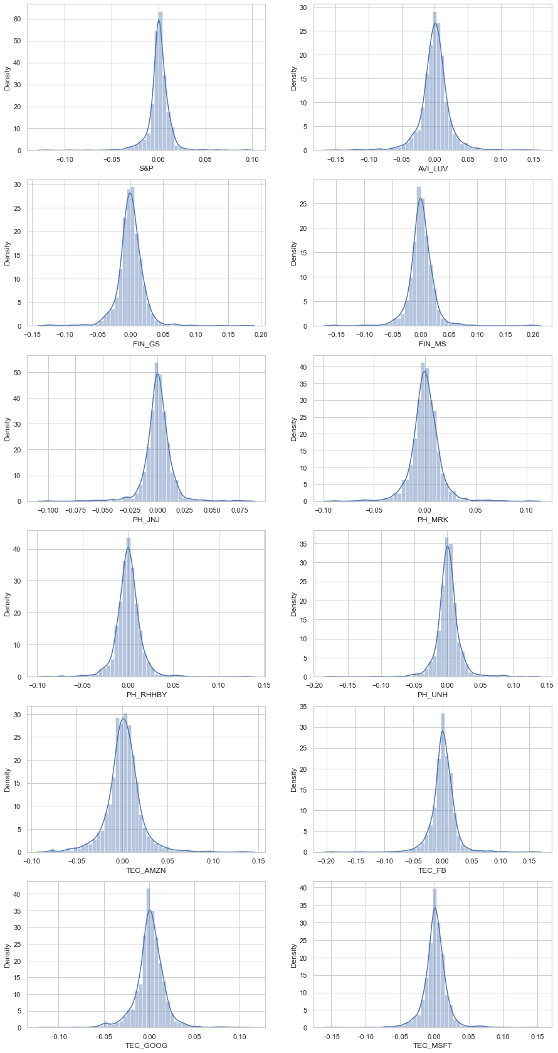

Slide 18
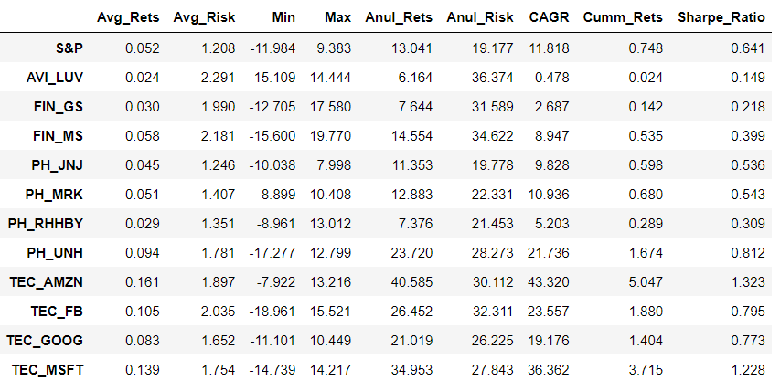
Risk Matrix
Risk Matrix is calculated for only the selected stocks across sector, this matrix helps us to further select the stocks according to the clients requirements.

Slide 19
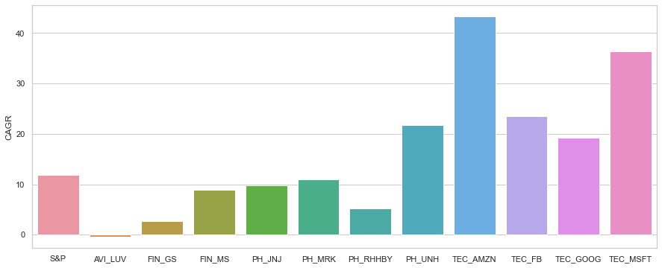
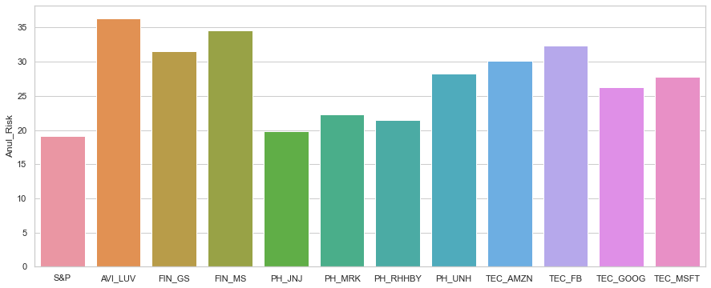
The CAGR measures the return on an investment over a certain period of time.
A negative CAGR would indicate losses over time rather than gains. In our case only Aviation sectors show losses.

Slide 20
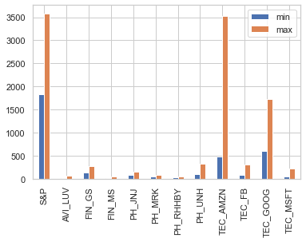
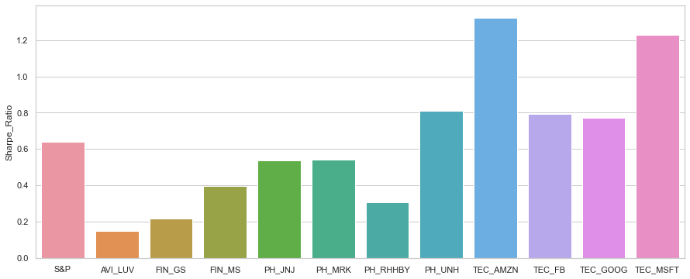
The Sharpe ratio adjusts a portfolio’s past performance or expected future performance for the excess risk that was taken by the investor.
A high Sharpe ratio is good when compared to similar portfolios or funds with lower returns

Slide 21
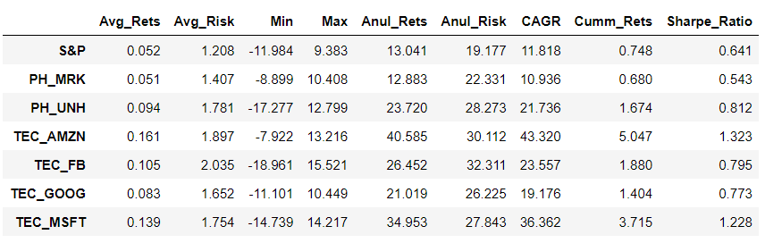
Risk Matrix for the selected stocks.
This final risk matrix looks to dominated by the IT stocks and Pharma and Healthcare stocks, rest other stocks perform below par with market. Hence will be creating Portfolio for the clients from these stocks.

Slide 22
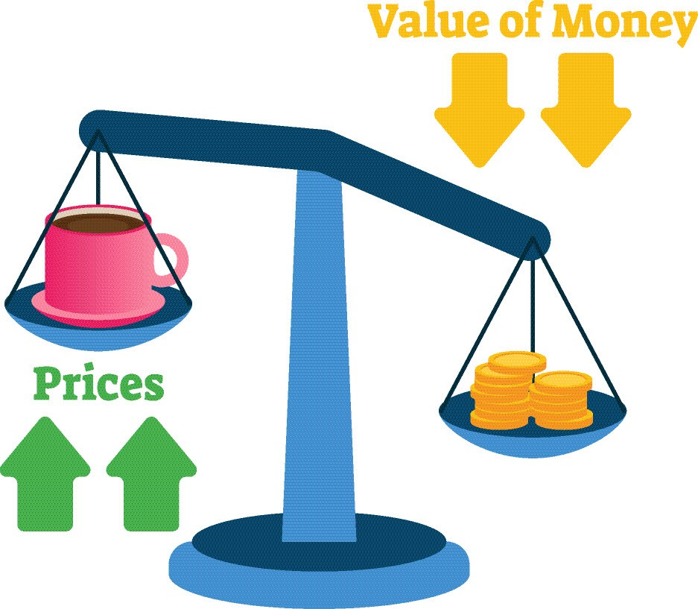
Inflation
Considering a inflation of 2% per year, after five years it will be around 10.41% , hence its impact on the current investments needs to anticipated.

Slide 23


Slide 24

Investors Portfolio
Mr. PATRICK JYENGAR

Slide 25
Investor Persona
Mr. Patrick Jyengar
Investments:$500K
Goals : $1.0M after 5 years with less risk.
Objective : To buy minority portion of Naturo and maintain a decent standard of living post retirement.
Age: 55 years
1st Generation Entrepreneur. Started Jyengar Waterworks(JWW)

Slide 26

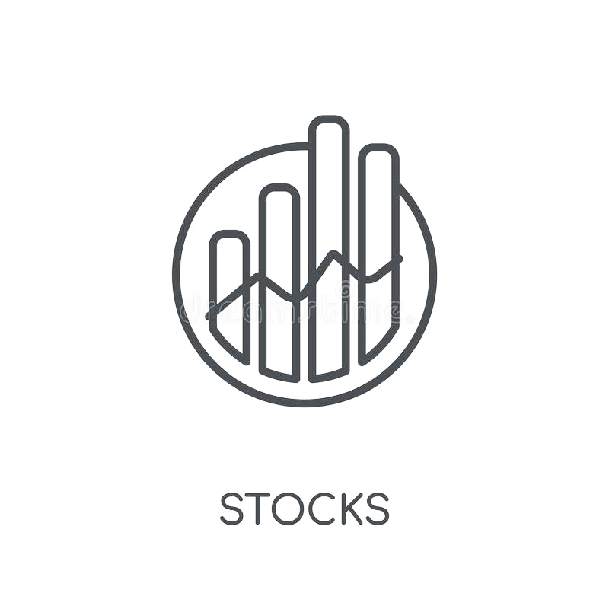



Market Summary
Aviation:
IT/Technology:
Banking/Financial Services and Insurance:
Pharmaceuticals/Healthcare/Life Sciences:

Slide 28
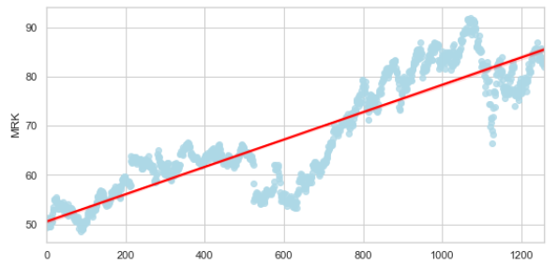
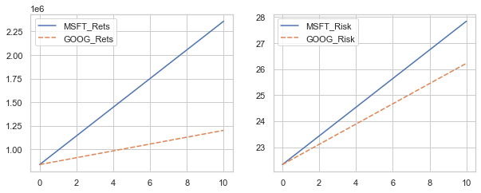
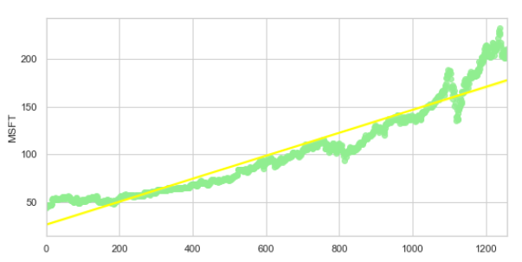

Slide 29
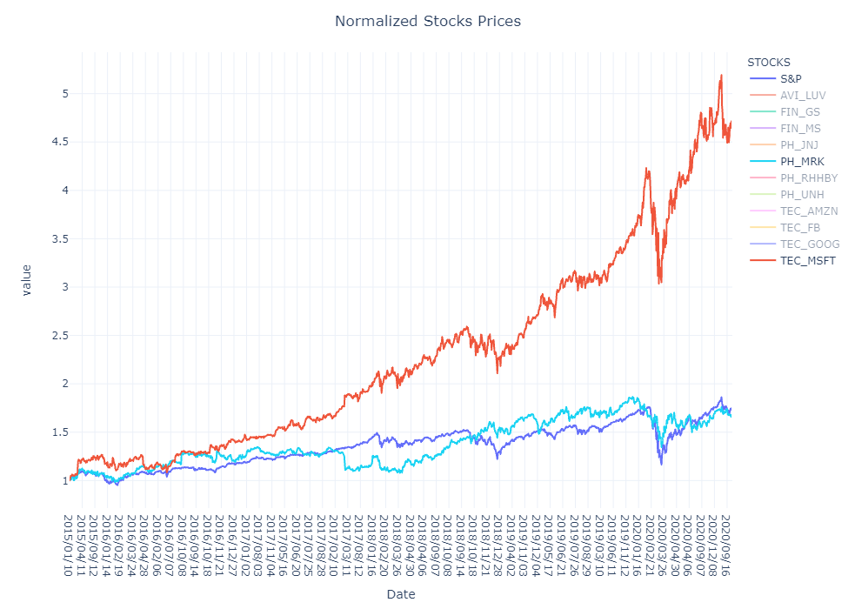


Slide 30
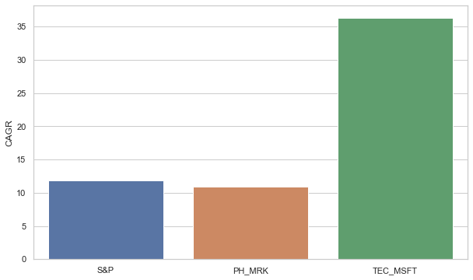
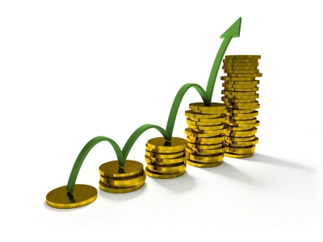
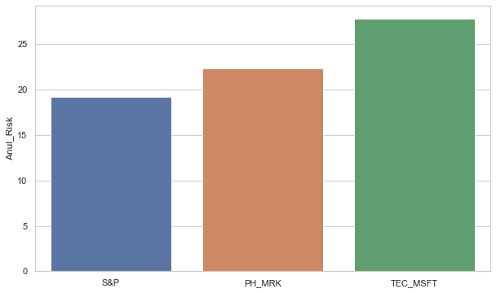
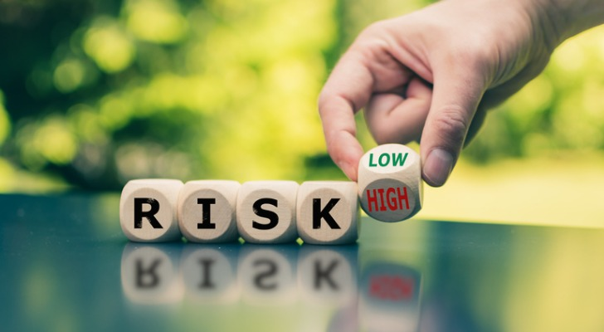

Slide 31
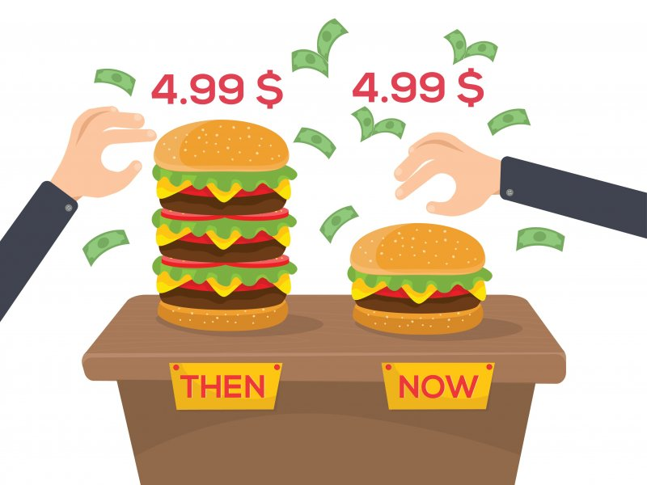
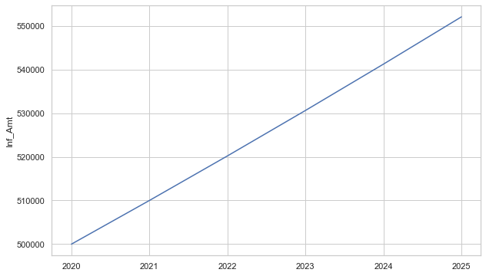
Inflation
The inflation at 2 % per years will cost $ 104100 after the tenure of 5 years. Hence the goal of $1.0M is needed to updated to $ 1104100.

Slide 32
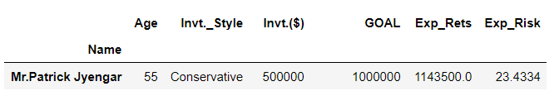
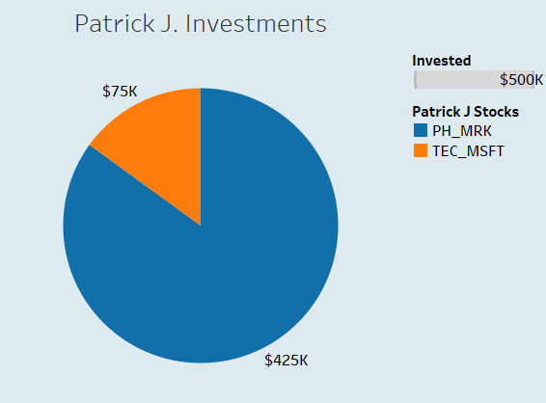
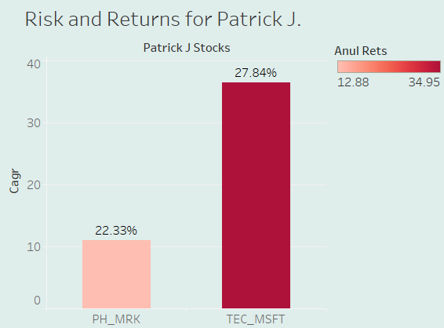

Slide 33
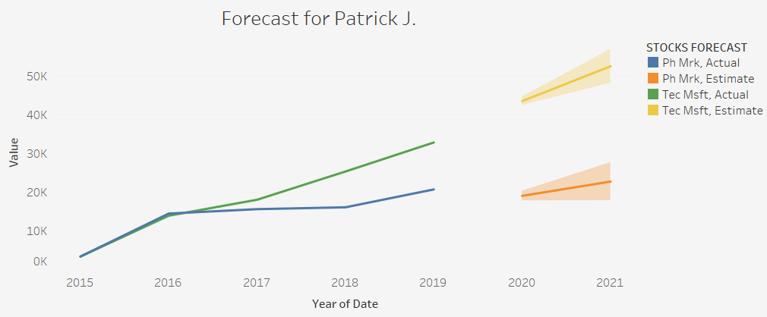
Mr. Patrick Jyengar is expected to get 128.7% returns with a risk of 4.25% more than the market viz. S&P500.

Slide 34

Happy Investing…..

Slide 35

Investor Portfolio
MR. PETER JYENGAR

Slide 36
Investor Persona
Mr. Peter Jyengar
Investments: $1.0M
Goals : Higher Returns after 5 years with high risk.
Objective : Inorganic Expansion of JWW.
Age: 32 years
Inherited Jyengar Waterworks(JWW), from his father Mr. Patrick Jyengar

Slide 37
Market Summary
Aviation:
IT/Technology:
Banking/Financial Services and Insurance:
Pharmaceuticals/Healthcare/Life Sciences:

Slide 39
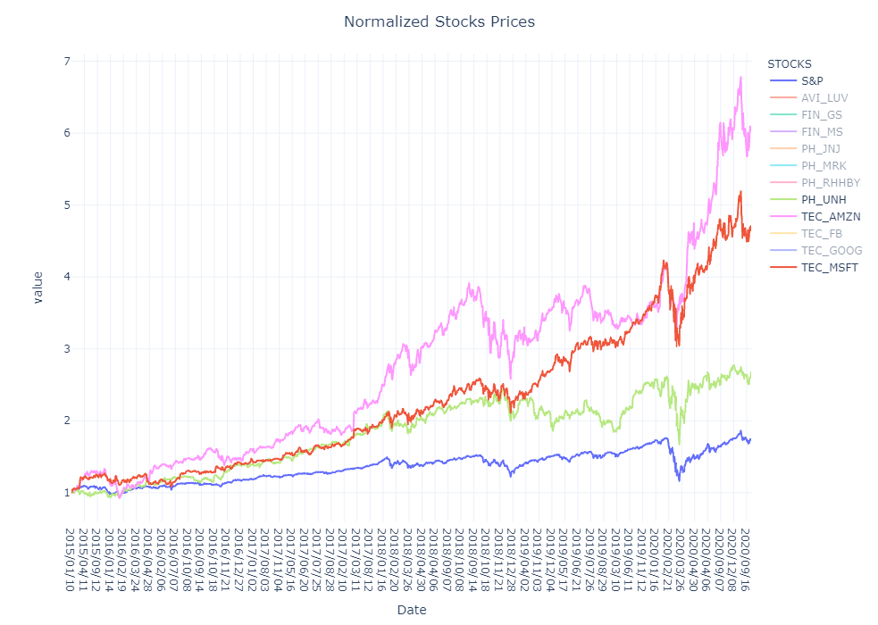


Slide 40
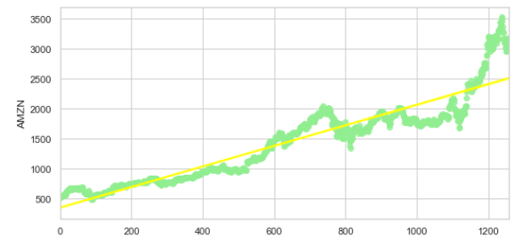
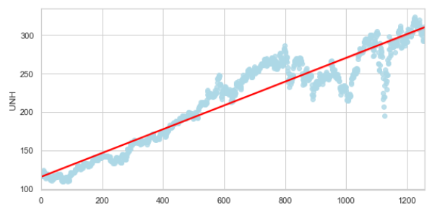
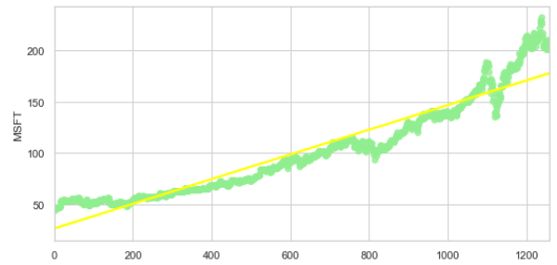

Slide 41
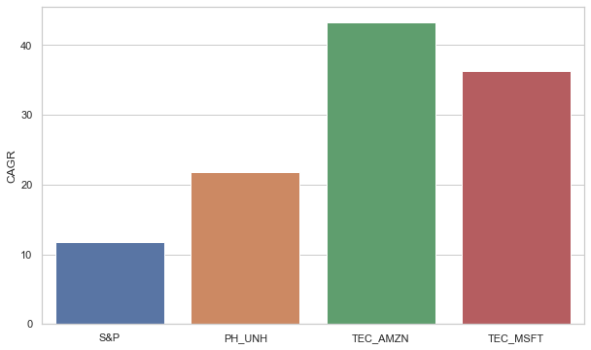
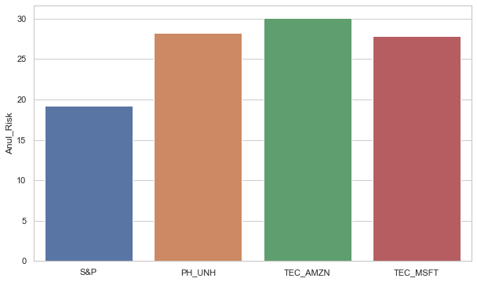


Slide 42
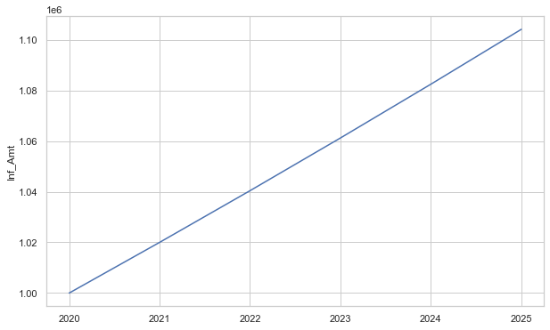

With 2% inflation every year, $ 1,04,080.80 are additionally required on $1.0M. To compensate this loss and to get 5 times return on the investments, we target to reach $ 55,20,500 at the end of 5 years

Slide 43
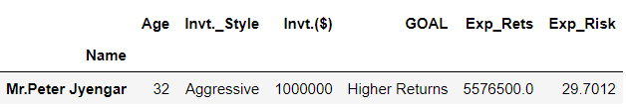
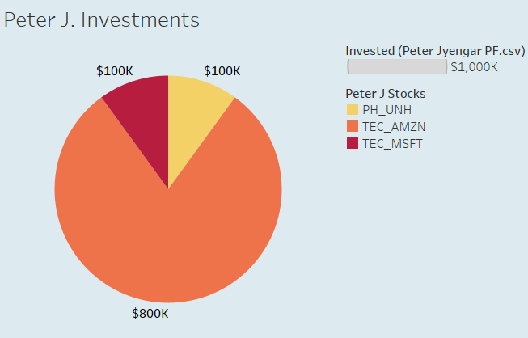
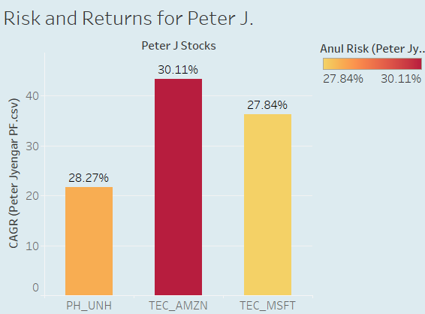

Slide 44

Mr. Peter Jyengar will be getting a returns of whopping 457.65% after five years on his investments with as added risk of 10.52% over the market risk.

Slide 45

Happy Investing…..

